Slide 1
Hemnet Webscraping project
David Wullimann
2024-02-13

Slide 2

Disclaimer!
Not an employee of Booli

Slide 3
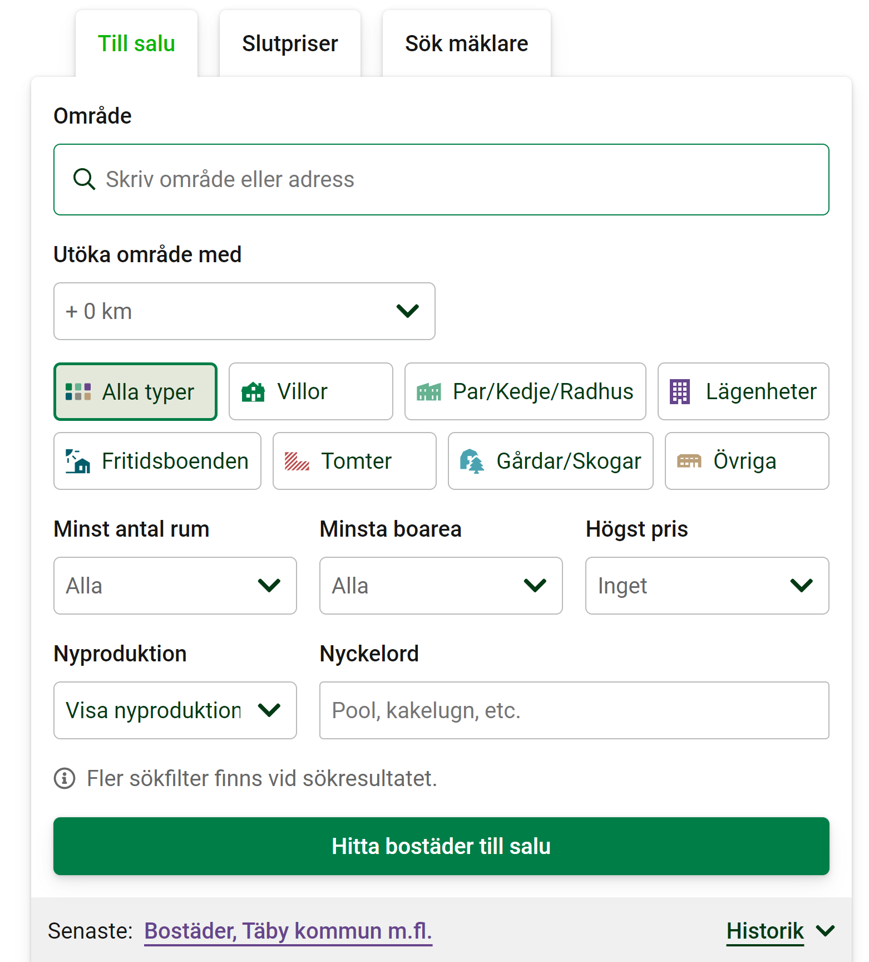
Filter page
My own filters:
Min: 2,5 rooms
Min: 40 sqm
Max based on budget

Slide 4
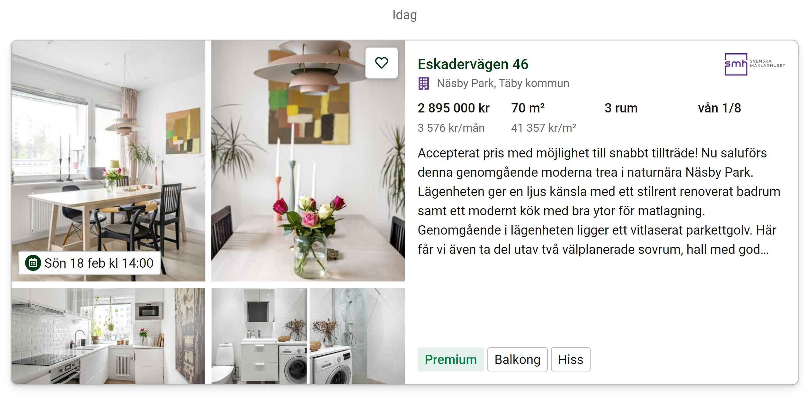
Container > Div > target
Elements from the box!
50 per page
3 pages
Used: Address, Location, Price, Size, Rooms
Not used: Floor, text, tags, images

Slide 5
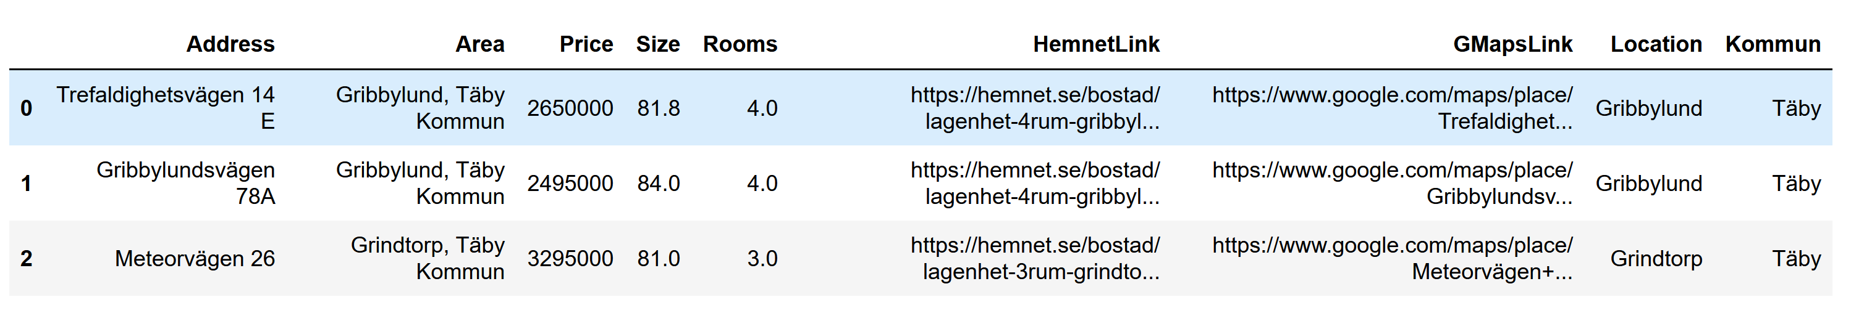
Data set
143 objects (3 pages)
Removed one outlier (13 rooms, 1.5 m.kr)

Slide 6
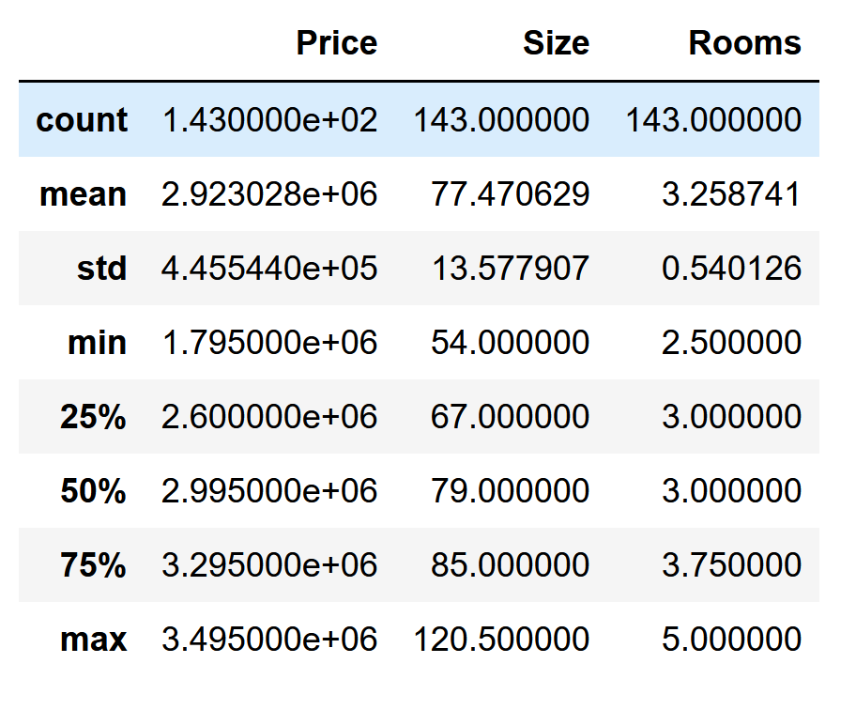
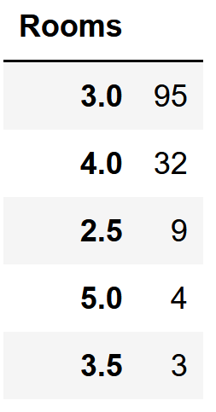
Search statistics

Slide 7
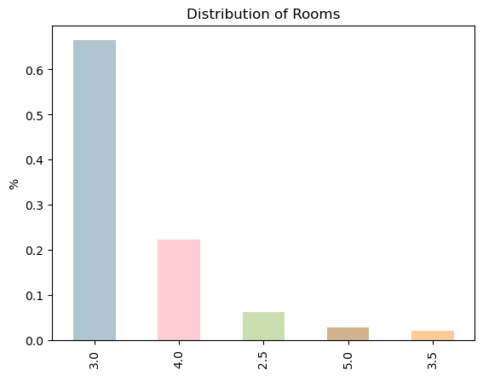
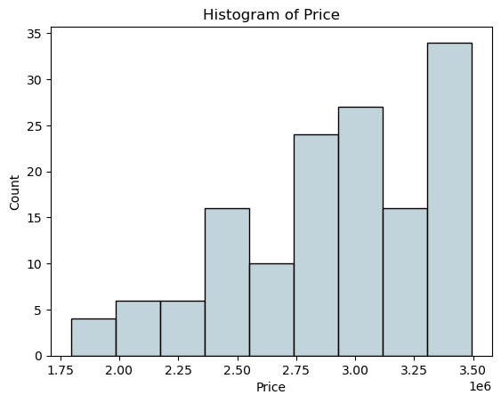
Data visualization

Slide 8
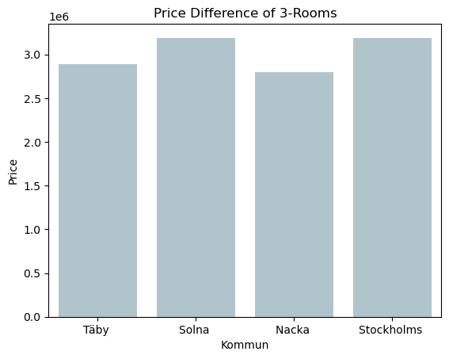
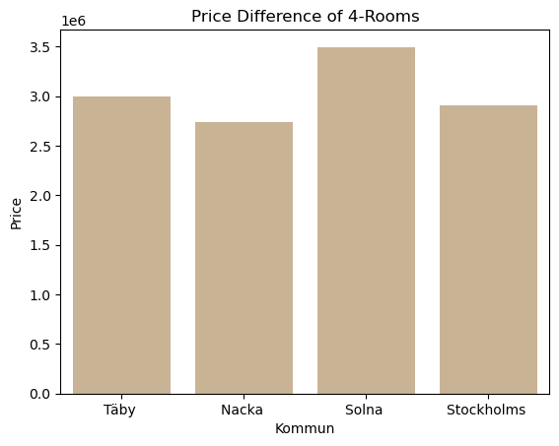
Data visualization

Slide 9
Challenges
How to iterate & set up loop structure for container
Could not get tags due to length issues
When to change the html code (CSS selector) and when to adjust in Python
Getting what I want
To avoid getting objects outside the search, find the right div to query from!
data-testid="result-list"

Slide 10
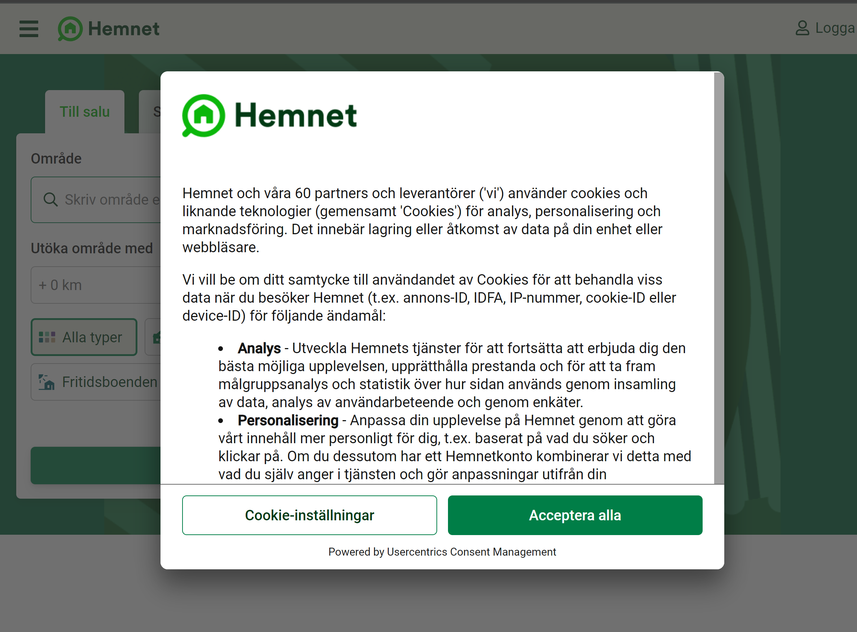
Shadow DOM
(Document Object Model)
Each website is represented by an HTML DOM, a tree-like structure consisting of HTML elements (e.g. paragraphs, images, videos) and text.
Shadow DOM allows the separate DOM trees to be attached to the main DOM while remaining isolated in terms of CSS inheritance and JavaScript DOM manipulation.
The CSS and JavaScript codes of separate shadow DOM components do not clash, but the downside is that you can't easily access the content from outside.
...driver.shadowRoot.querySelect(’button’)

Slide 11
Future ideas
Get alerted with e-mail/text-message of new objects
Make excel-file with clickable-links
Annotate each object with time on Hemnet
Add to data set what I did not have time for (floor, tags etc.)
ChatGPT functionality (personal broker)

